Slide 1

DATA ANALYTICS Unit 3 Project 3
Furhan Babar
Mary GraCe Boyd

Slide 2

Harlem Hospital Center
COVID-19 Positive cases analysis

Slide 3
Overview:
Key stakeholders
About COVID-19
Research questions
Data gathering, connection and wrangling
Stats and findings related to covid-19
Utilization impact of COVID-19 on inpatient (IP) and outpatient (OP) services
Revenue impact of COVID-19 on hospital
Conclusion

Slide 4
Key Stakeholders:
Executive Leadership: CEO, CFO and COO
Clinical Leadership: CMO, CNO and Chief of Service
Operational Leadership: Department Administrators

Slide 5
What is COVID-19?
COVID-19 is the name of the “novel coronavirus” disease,
SARS-CoV-2 is the name of the virus that causes COVID-19.
COVID-19 first case was reported in Hubei Province of China in December 2019.
COVID-19 spreads person-to-person via respiratory droplets from coughs or sneezes (like the flu), by touching an object or surface with the virus on it, then touching mouth, nose, or eyes.
Some common risk factors for severe illness may include:
Older age
Underlying chronic medical conditions
Notes:
Coronaviruses are a large family of viruses, most common known types were Middle East Respiratory Syndrome (MERS) and Severe Acute Respiratory Syndrome (SARS).

Slide 6
Symptoms of COVID-19
TIREDNESS
HIGH FEVER
Emergency Warning Signs
Fever or chills
Trouble breathing
Persistent pain or pressure in the chest
New confusion
Inability to wake or stay awake
Bluish lips or face
Common Symptoms
Fever or chills
Cough
Shortness of breath or difficulty breathing
Fatigue
Muscle or body aches
Headache
New loss of taste or smell
Sore throat
Congestion or runny nose
Nausea or vomiting
Diarrhea
DIFFICULTY BREATHING
DRY COUGH

Slide 7
Research Questions
What are the correlation between data?
Community acquired vs hospital acquired
Age and infection rate
Age, gender and service department
Age, admit month, and admit year
Length of stay and age
Lab-related information
Positive cases by zip code
Number of patients by admit date
Gender-related information
Number of cases (i.e. by month)

Slide 8
Data Gathering
This data set was initially compiled to be submitted to the NYCHHC Central Office. Central office would then aggregate the data from all facilities and report it to the State Health Department.
This data set is exclusively of patients who had tested positive for COVID-19.
Raw Data Information
Data source – EPIC Reporting Workbench
36 columns | 839 rows
Mixed data types (string, integer, float)
Year range of admission (2018-2020)
No negative or PUI cases are part of this dataset

Slide 9
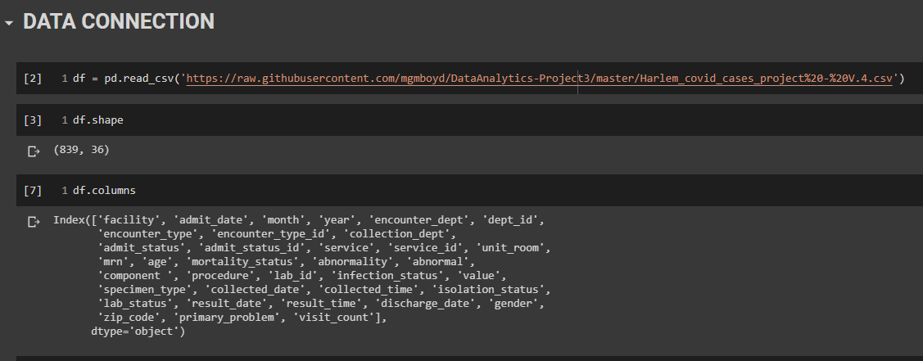
Data Connection

Slide 10
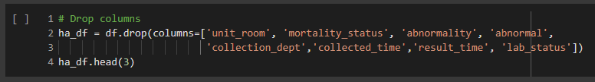

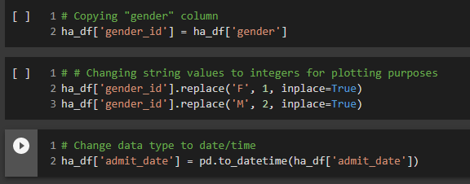
Data Wrangling
Due to redundant and unnecessary information, some of the columns were dropped from the dataset
New columns were created to properly aggregate the sum of cases by admit date
Some data type were changed to ensure the compatibility of data with Python functions and libraries

Slide 11
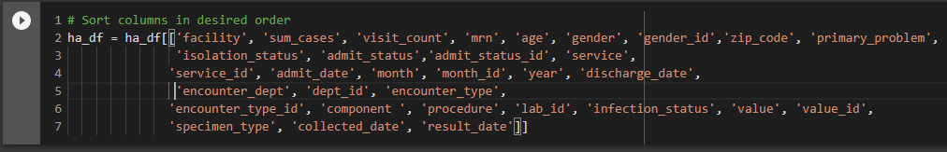


Data Wrangling
Columns were sorted in relational pattern for easy viewing and analysis
Columns were also added to properly aggregate the data
Data was sorted by admit date in ascending order to make the Head and Tail function more meaningful
Unique values for some columns were obtained for data analysis

Slide 12






INFOGRAPHICS

Slide 13
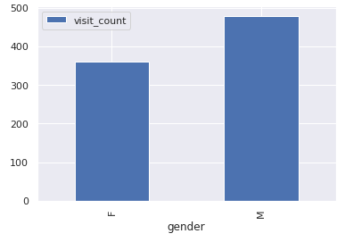
Visit Count by Gender
Notes:
Total Male Patients – 479
Total Female Patients - 360

Slide 14
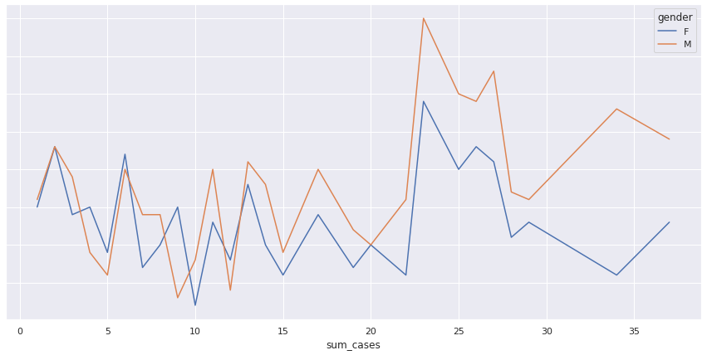
Visit Count by Gender
Notes:
Total Male Patients – 479
Total Female Patients – 360
Looking at the total number of cases per month, the frequency of cases shows that there are more male patients that were affected by COVID-19 in Harlem

Slide 15
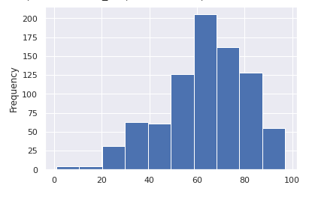
Left Skewed (Age)
AGE
Notes:
The distribution bar chart concentrated on Age dimension is skewed to the left. This skewedness means that most of our patients were of age 50 + with an average age of 63.
At the same time this chart also displays that we had two pediatrics patients with the age bracket of 11 months to 18 years of age.

Slide 16
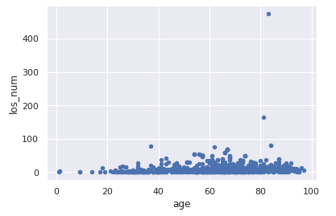
Length of Stay & Age

Slide 17
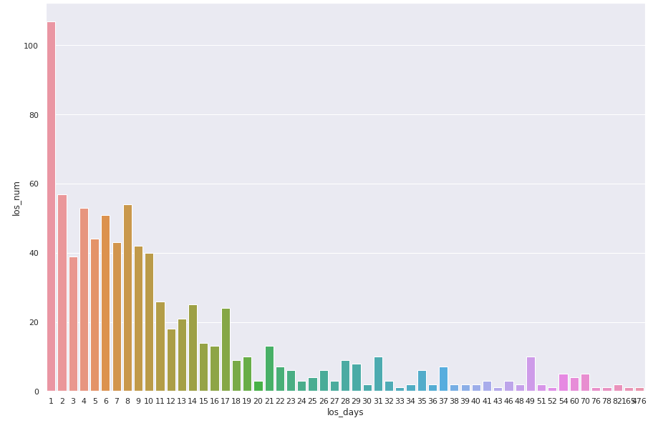
LOS by number of patients
Notes:
This chart shows us that number of days a patient stayed in the hospital. Looking at the first bar from the left, we can conclude that majority of our patients who tested positive were discharged the same day and must have had mild symptoms of Covid-19. Such patients were advised to self quarantine and follow ups were made by clinical staff on regular bases. At the same time we had patients who stayed for more the two months due to high acuity of their illness.

Slide 18

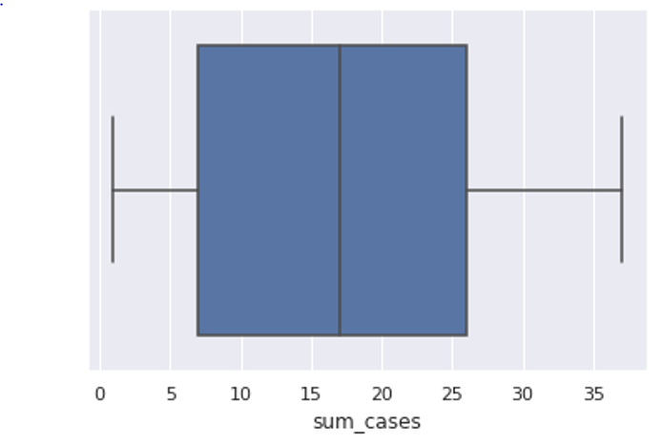

BOX PLOT
What was the highest number, average and least number of cases reported in a day?
Notes:
A boxplot is a graph that gives you a good indication of how the values in the dataset are spread out. The interquartile range is a measure of variability, based on dividing a data set into quartiles. It contains the middle 50% of a distribution and is a robust measure of statistical dispersion. It can also be used to find outliers in data.
The highest number of cases were reported on the 1st of April with the total of 37 cases. The median is around 17, separating the higher half from the lower half of our dataset.

Slide 19
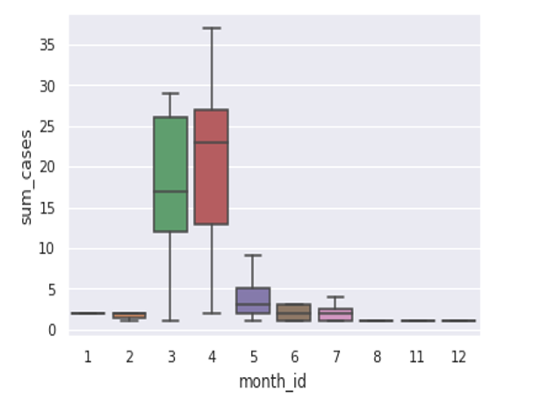
BOX PLOT
Total # of cases per month

Slide 20
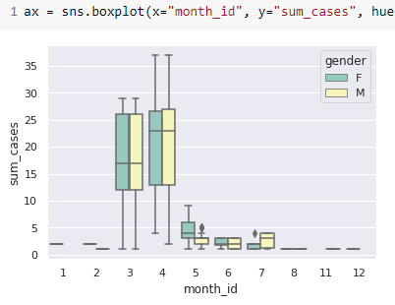
BOX PLOT
Total # of cases per month
(correlation with gender)

Slide 21
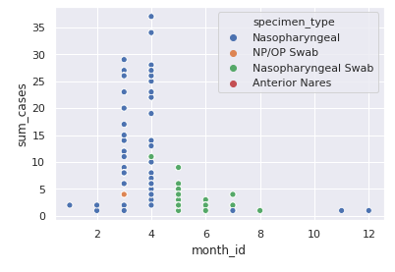
SCATTER PLOT
Total # of COVID-19 cases by Specimen type and by month
Notes:
Grace

Slide 22
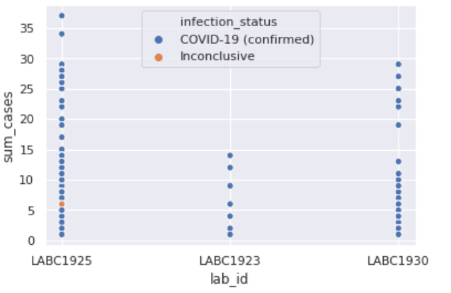
SCATTER PLOT
Total # of COVID-19 test processed by each Lab

Slide 23
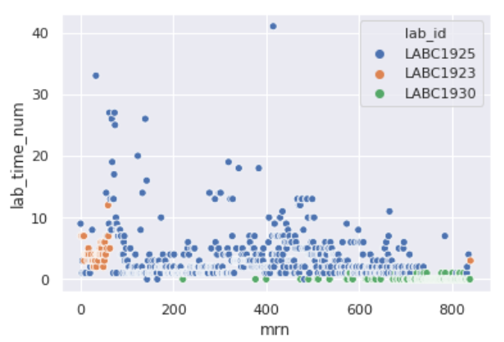
SCATTER PLOT
Total # of days for Labs to process the COVID-19 test for each patient
Notes:
We also looked at the number of days it took for each lab to process and return the result. On average it took 4 days to get the result back from the labs. The highest number of days for one patient was 42 days. LAB1930 had the quickest turnaround time.

Slide 24
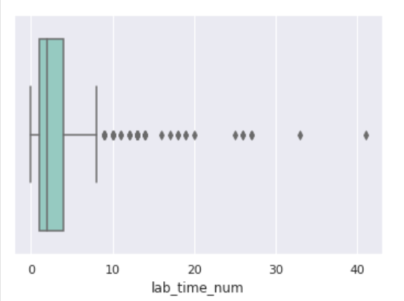
BOX PLOT
Total # of days for Labs to process the COVID-19 test for each patient

Slide 25
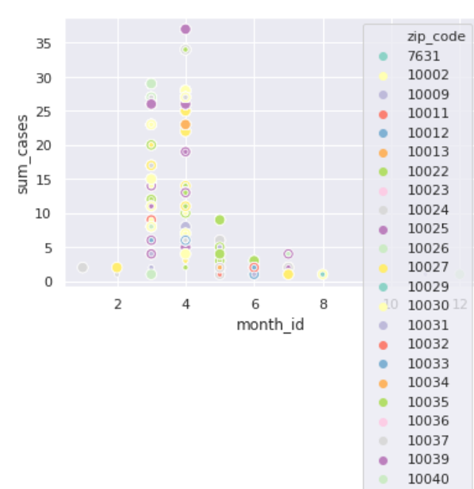
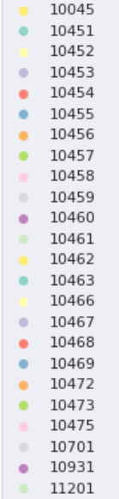
SCATTER PLOT
Patients who were treated at Harlem by zip code

Slide 26
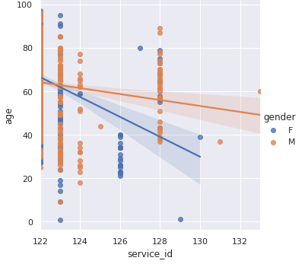
Regression Analysis – Correlation b/w Pt Age, Gender and Service line
Correlation between age, gender and service line
Medicine 122 Pediatric 129
Emergency 123 Urology 130
Surgery 124 Plastic 131
SICU 125 Ext Obs 133
OB 126
CCU 127
MICU 128

Slide 27
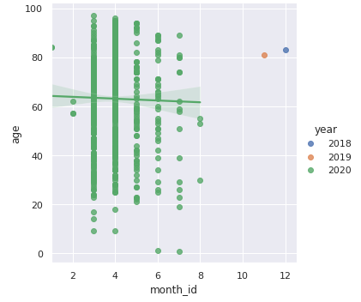
Regression Analysis

Slide 28
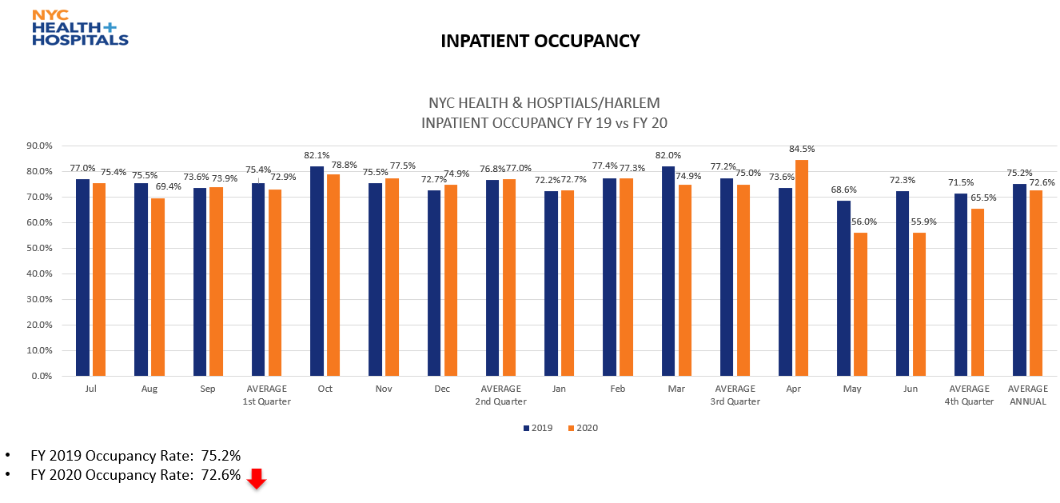
UTILIZATION IMPACT OF COVID-19 ON IP SERVICES

Slide 29
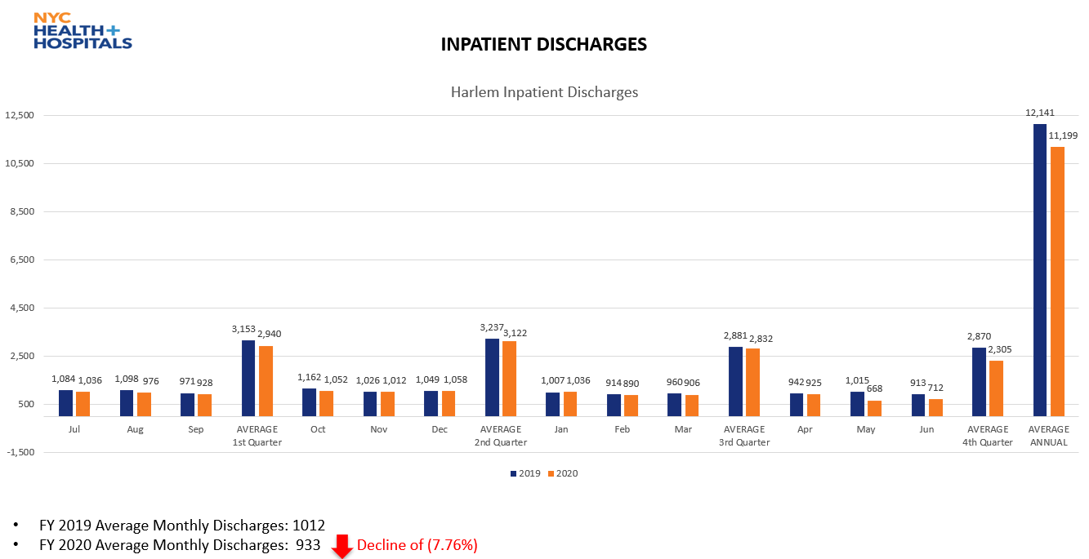
UTILIZATION IMPACT OF COVID-19 ON IP SERVICES

Slide 30
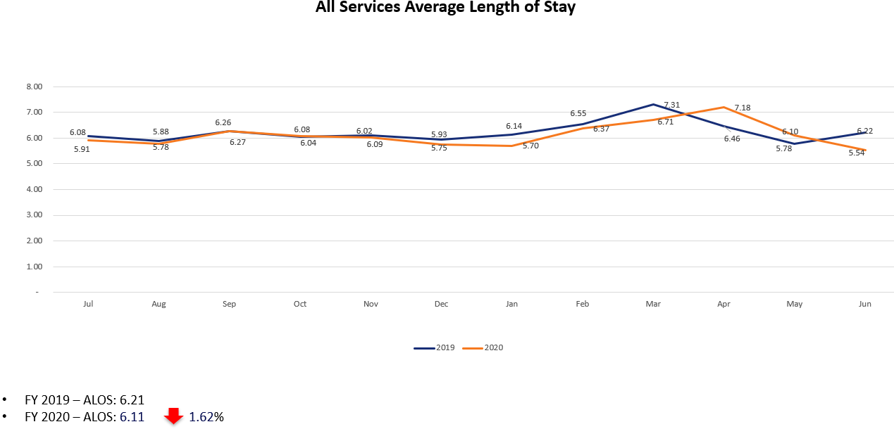
UTILIZATION IMPACT OF COVID-19 ON IP SERVICES

Slide 31
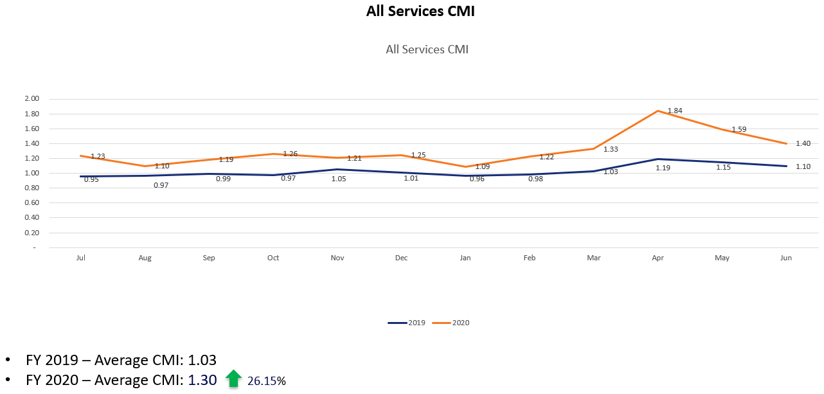
UTILIZATION IMPACT OF COVID-19 ON IP SERVICES

Slide 32

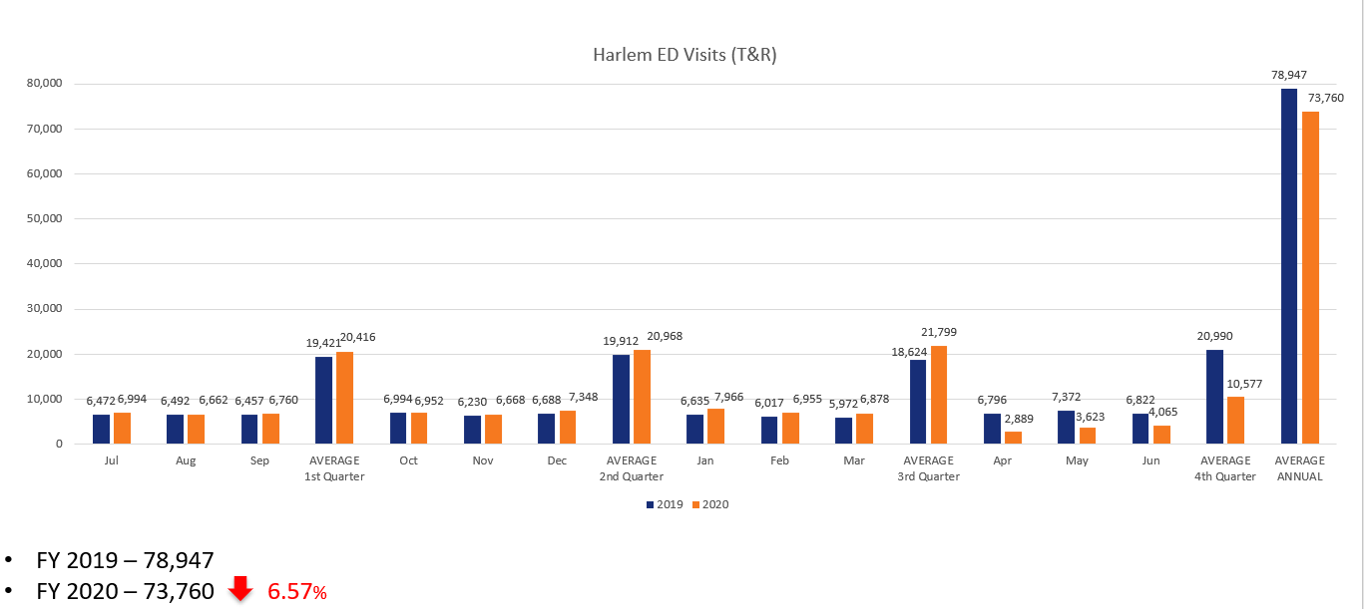
UTILIZATION IMPACT OF COVID-19 ON ED SERVICES

Slide 33
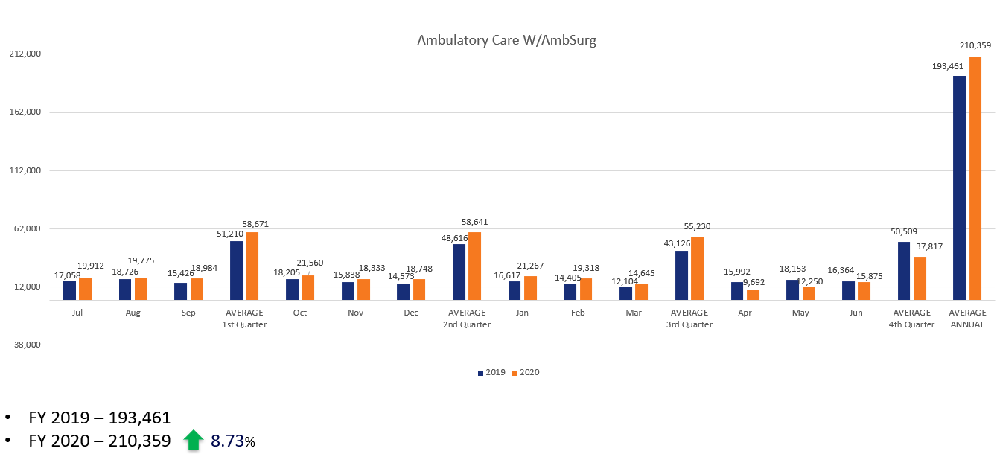

UTILIZATION IMPACT OF COVID-19 ON OP SERVICES

Slide 34
Conclusion
In conclusion, based on our analysis above, we can gladly report that the covid19 cases have significantly reduced in Harlem hospital as it has for the State of New York. Following are the facts we uncovered during our data analysis:
The first patient to be tested positive for Covid-19 was on 11th of March. The same month, 263 positive cases were registered in total.
The real spike in cases came in the following month of April, where 441 cases were reported.
The highest number of cases were reported on the 1st of April with the total of 37 cases.
Based on gender, male patients out numbered female counterparts.
Interestingly, the zip code analysis revealed that for our covid-19 positive patient population was from all over the NYC.
The distribution bar chart concentrated on Age dimension is skewed to the left. This skewedness means that most of our patients were of age 50 + with an average age of 63.

Slide 35
Conclusion
The average length of stay bar chart also reveals that majority of our patients who tested positive were discharged the same day and must have had mild symptoms of Covid-19. Such patients were advised to self quarantine and follow ups were made by clinical staff on regular bases. At the same time we had patients who stays for more the two months due to high acuity of their illness.
We also analyzed the number of tests studied by each lab that was employed using the scatter chart. Based on our findings, most of the tests were sent to LABC1925 followed up by LABC1930.
We also looked at the number of days it took for each lab to process and return the result. On average it took 4 days to get the result back from the labs. The highest number of days for one patient was 42 days.
When we analyzed the patient data by department, the busiest departments were Medicine, MICU and Surgery.
When also looked at our patient population in terms of Community acquired vs Hospital acquired covid-19 infection. Even though there is no conclusive evidence, based on the admit date, which happens to be prior the emergence of covid-19 cases and testing at Harlem Hospital, we found 7 such patients who were tested positive for Covid-19.

Slide 36
Conclusion
The data also tells us that post April 28th, the number of patients with positive test results started to slow down significantly. Looking at the change in percentage charge we can come to conclusion that by the month of May, covid-19 cases were dropped by 83% compare the month of April. The downward trends continued in covid-19 + cases as a result of smart lockdowns, education and more preventive measures taken by government, Hospitals and communities collectively .

Slide 37
